Slide 1
Database State Generation via Dynamic Symbolic Execution for Coverage Criteria
Kai Pan, Xintao Wu
University of North Carolina at Charlotte
Tao Xie
North Carolina State University
DBTest11
June 13, Athens, Greece

Slide 2
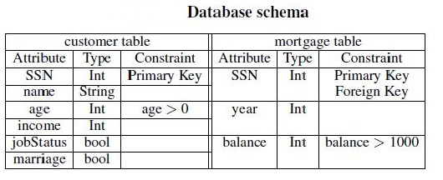
We leverage DSE as a supporting technique to generate database states to achieve high code coverage (BVC and CACC in addition to branch coverage).

Slide 3
Outline
Introduction:
-- Dynamic Symbolic Execution(DSE)
-- Advanced structural coverage criteria(BVC and LC)
Approach
Evaluation
Related work
Conclusion and future work

Slide 4
Dynamic Symbolic Execution(DSE) -- Revisited
DSE: An effective automatic test-input generation approach that combines concrete execution with symbolic execution
Details:
-- Starts with default or arbitrary inputs and executes the program concretely
-- Performs symbolic execution to collect symbolic constraints on the inputs simultaneously
-- Flips a branch condition and conjuncts it with constraints from the prefix of the executed path
-- Sends the conjuncted conditions to a constraint solver to generate new inputs for the uncovered paths

Slide 5
DSE in Testing Database Applications -- Revisited
When DSE is applied on database applications, the symbolic execution collects constraints over both the program inputs and the symbolic database, by symbolically tracking the concrete SQL queries executed along the execution path
Generates both program input values and corresponding
database records via a constraint solver
Related work:
M.Emmi, R.Majumdar, and K.Sen. Dynamic test input generation for database applications. In ISSTA, 2007.
K. Taneja, Y. Zhang, and T. Xie. MODA: Automated Test Generation for Database Applications via Mock Objects. In ASE 2010

Slide 6
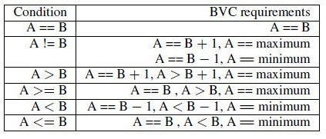
Boundary Value Coverage
Boundary Value Coverage(BVC): requires to execute programs using values from both the input range and boundary conditions. This is because program errors tend to occur at extreme or boundary points.
Example: for integers A and B in one expression, we have:

Slide 7
Logical Coverage
Logical Coverage (LC): involves instantiating clauses in a logical expression (predicate) with concrete truth values.
Predicate/Clause/Combinatorial/Active Clause coverage
Correlated Active Clause Coverage (CACC), value of a logical expression is directly dependent on the value of the clause that we want to test
Formally, for each predicate p and each major clause c_{i} ∈ p, choose minor clauses c_{j} , j≠ i so that c_{i} determines p.(required that p(c_{i} = true) ≠ p(c_{i} = false).)

Slide 8
Enforcing CACC and BVC
Example: in the example code (Line 20), for the predicate pc4 = (bal>=250000||employed && married) with the target evaluation result as true
We choose rows 1 and 4 from the table to enforce CACC

Slide 9
Enforcing CACC and BVC(cont’d)
To enforce BVC on the clause “(bal>=250000)”, we get {bal=250000, bal>250000, bal=maximum}
For the entire predicate, we get the following six instantiations:
{bal=250000, employed=true, married=false},
{bal>250000, employed=true, married=false},
{bal=maximum, employed=true, married=false},
{bal=250000-1, employed=true, married=true},
{bal<250000-1, employed=true, married=true},
{bal=minimum, employed=true, married=true}.

Slide 10
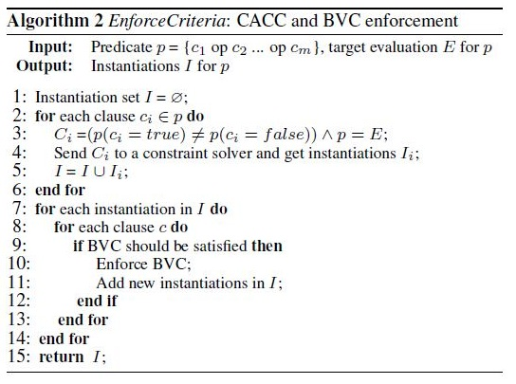
Enforcing CACC and BVC(cont’d)
In general, given a predicate and a boolean evaluation as input, we generate instantiations using:
CACC
BVC

Slide 11
Our work
Our approach leverages DSE to track how the inputs to the program under test are transformed before appearing in the executed queries and how the constraints on query results affect the later program execution.
We use Pex, a state-of-the-art DSE engine for .NET to illustrate our idea
The approach can be extended to other DSE engines for other programming languages

Slide 12
Pex APIs
APIs provided by Pex help users fetch symbolic expressions:
-- PexSymbolicValue.ToString() to get the target query string at each query execution point
-- PexSymbolicValue.GetRelevantInputNames<Type>() to detect the data dependency between the execution point and program input parameters.
-- PexSymbolicValue.GetPathConditionString() to retrieve the path condition at the execution point

Slide 13
Illustrative example
Our focus: how to generate sufficient database states to satisfy BVC and CACC .
Challenges:
Input parameters involved in both embedded queries and branch conditions(e.g. int inputAge)
Branch conditions involve variables that are related with returned database attribute values(e.g. Line 20)

Slide 14
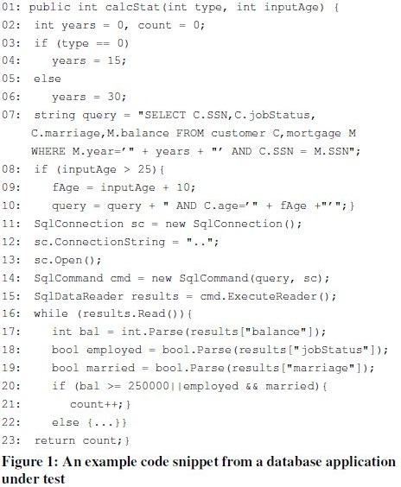
Illustrative example(cont’d)
type=0,inputAge=30
We use path P (where branch conditions in Lines 03, 08, 16, and 20 are true) and program inputs (type = 0, inputAge = 30) as an example
We get path condition PC = pc1 ∧ pc2∧ pc3 ∧ pc4, where pc1 = (type == 0), pc2 = (inputAge > 25), pc3 = (results.Read() == true), and pc4 = ((bal >= 250000 || employed && married) == true).

Slide 15
Illustrative example(cont’d)
We get the concrete executed query string Q :
SELECT C.SSN, C.jobStatus, C.marriage, M.balance
FROM customer C, mortgage M
WHERE M.year=15 AND C.SSN=M.SSN
And C.age=40
and the symbolic query string Qsym:
SELECT C.SSN, C.jobStatus, C.marriage, M.balance
FROM customer C, mortgage M
WHERE M.year=:years AND C.SSN=M.SSN
AND C.age=:fAge

Slide 16
Illustrative example(cont’d)
For Q and Qsym, the WHERE clause contains host variables that appear directly in branch conditions or are dependent on host variables in branch conditions (Line 08)
Hence, enforcing BVC on this branch condition (Line 08) incurs constraints on the generated data.

Slide 17
Illustrative example(cont’d)
Branch condition (Line 20) contains three host variables (bal, employed, and married) that retrieve values from three database attributes (M.balance, C.jobStatus, C.marriage) in the returned result set
Enforcing CACC and BVC on the branch condition(Line 20) incurs new constraints on the generated data

Slide 18
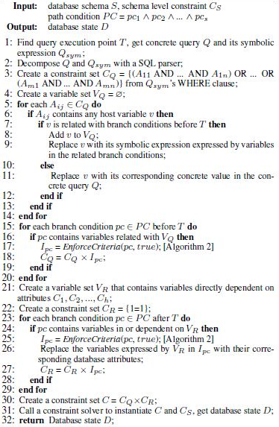
Embedded query(in a DPNF form):
Part1: Deriving constraints by examining the WHERE clause and the branch conditions before the query’s execution.
Part2:Deriving constraints by examining the SELECT clause and the branch conditions after the query’s execution.

Slide 19
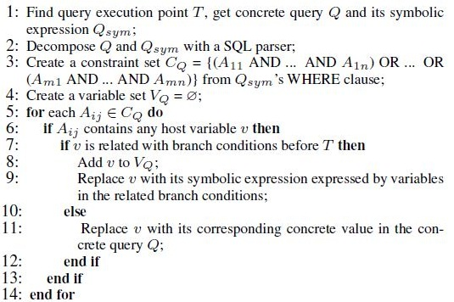
Deriving Constraints from Embedded Query
Constraints from executed queries:

Slide 20
Deriving Constraints from Embedded Query(cont’d)
Set CQ = (A11 AND …AND A1n) OR … OR (Am1 AND …AND Amn) --- the WHERE clause of Qsym
For each Aij, we check whether it contains host variables.
For each contained host variable,
if it is related with any branch condition, we add it to V_{Q} and replace it with symbolic string expressed by variables in the related branch conditions.
Otherwise, we replace the variable with its concrete value contained in the concrete query.

Slide 21
Deriving Constraints from Embedded Query(cont’d)
Using our example code:
-- C_{Q} = {M.year=:years AND C.SSN= M.SSN AND C.age=:fAge}.
-- For M.year=:years, we replace “years” with the value “15”.
-- For C.age=:fAge, we replace “fAge” with “inputAge + 10”.
-- For C.SSN= M.SSN, we leave it unchanged.
-- C_{Q} = {M.year=15 AND C.SSN= M.SSN AND C.age=:inputAge + 10}.

Slide 22
Deriving Constraints from Embedded Query(cont’d)
Next, we check whether the branch condition pc along the execution path contains host variables related with the WHERE clause.
If yes, we enforce it with both CACC and BVC and get instantiations I_{pc}
We refine C_{Q} as C_{Q} = C_{Q} × I_{pc}.

Slide 23
Deriving Constraints from Embedded Query(cont’d)
Using our example code:
-- Enforcing BVC on inputAge> 25, we have instantiations
{inputAge=25+1, inputAge>25+1, inputAge=maximum}.
-- C_{Q} is then updated as
{M.year=15 AND C.SSN= M.SSN AND C.age=:inputAge+10 AND inputAge=25+1},
{M.year=15 AND C.SSN= M.SSN AND C.age=:inputAge+10 AND inputAge>25+1},
{M.year=15 AND C.SSN= M.SSN AND C.age=:inputAge+10 AND inputAge=maximum}.

Slide 24
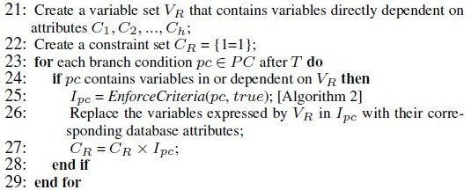
Deriving Constraints related with Query Result Set
For branch conditions after the SQL’s execution point, we check whether they contain host variables that are dependent on database attributes in the SELECT clause, and then enforce CACC and BVC.

Slide 25
Deriving Constraints related with Query Result Set(cont’d)
Using our example code: pc4 = ((bal >= 250000 || employed && married) == true) , we have CR
{bal=250000, employed=true, married=false},
{bal>250000, employed=true, married=false},
{bal=maximum, employed=true, married=false},
{bal=250000-1, employed=true, married=true},
{bal<250000-1, employed=true, married=true},
{bal=minimum, employed=true, married=true}.
We then replace host variables (e.g., bal) with database attributes (e.g., M.balance).

Slide 26
Combining Constraints
Finally, the set C = C_{Q}×C_{R} contains constraints on the generated database state to enforce CACC and BVC on the source code under test.
We send C together with the schema level constraints C_{S} to a constraint solver (Z3) to conduct the data instantiation

Slide 27
Evaluation
We conduct evaluations on two open source database applications.
RiskIt: 4.3K non-commented lines of code, a database containing13 tables, 57 attributes, and more than 1.2 million records
UnixUsage: 2.8K non-commented lines of code, a database containing 8 tables, 31 attributes, and more than 0.25 million records
We choose methods that have boundary values and/or logical expressions in branch conditions from the applications.

Slide 28
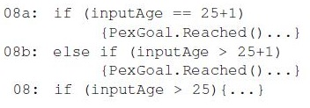
Evaluation(cont’d)
To measure CACC and BVC, we apply a tool [Pandita et al. ICSM10] that transforms the problem of achieving CACC and BVC to the problem of achieving block coverage by introducing new blocks through code instrumentation.
We use PexGoal.Reached() to identify whether each introduced block is covered. For example, the statement if (inputAge > 25) {...} in Line 08 becomes

Slide 29
Evaluation(cont’d)
We use the value of (n2 - n1)/n to capture the increase gained by Pex assisted by our approach in achieving CACC and BVC.
n denotes the total number of PexGoal.Reached() statements introduced in each method.
n₁ denotes the number of covered PexGoal.Reached() statements when running Pex (in addition to our program input generation tool) without applying our algorithm to generate new records.
n₂ denotes the number of covered PexGoal.Reached() statements when running Pex with the assistance of our algorithm.

Slide 30
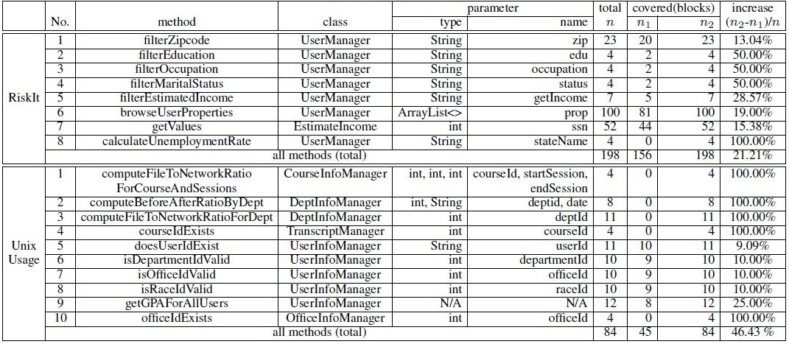
Evaluation(cont’d)
Evaluation results: our approach assists Pex to reach the full CACC and BVC coverage (a 21.21% increase on average for RiskIt and a 46.43% increase for UnixUsage).

Slide 31
Related work
Coverage criteria:
-- BVC and LC [Ammann et al. ISSRE 2003, Kosmatov et al. ISSRE 2004]
-- test generation to reach high BVC and LC [Pandita et al. ICSM 2010]
DB application testing:
-- generating database states from scratch[Chays and Shahid DBTest 2008, Emmi et al. ISSTA 2007, Taneja et al. ASE 2010]
-- using existing database state[Li and Csallner DBTest 2010, Pan et al. UNC-Chalotte TR-2011]

Slide 32
Related work (cont’d)
SQLFpc (short for SQL Full Predicate Coverage)
A coverage criterion focusing on an isolated SQL statement, based on the Modified Condition/Decision Coverage(MC/DC).
Mutates a given SQL query statement into a set of queries that satisfy MC/DC with the aim of detecting faults in the SQL statement.
[Tuya et al. 2010, Riva et al. AST 2010].
Our work leaves the embedded SQL statement unchanged. Instead, we generate database states with the aim of detecting faults in source code.

Slide 33
Conclusion
We developed a general approach to generating test database states that can achieve BVC and CACC in database application testing.
We expect that testers can detect more faults that occur in boundaries or involve complex logical expressions.
We implemented our approach in Pex, a DSE tool for .NET. Our evaluation demonstrated the feasibility of our approach.

Slide 34
Future work
We plan to investigate how to optimize the constraint collection and data instantiation.
We plan to study complex SQL queries (e.g., GROUPBY queries with aggregations) and extend our technique to multiple queries.

Slide 35
Thank you! Questions?
Acknowledgment: This work was supported in part by U.S. National Science Foundation under CCF-0915059 for Kai Pan and Xintao Wu, and under CCF-0915400 for Tao Xie.

