Slide 1
FlexMin: A Flexible Tool for Automatic Bug Isolation in DBMS Software
Kristi Morton*
University of Washington,
Department of Computer Science & Engineering
and
Nicolas Bruno
Microsoft
* Work done while visiting Microsoft Research, Redmond
Notes:
Hi I’m Kristi Morton, a graduate student at the UW. I worked with Nico Bruno this past summer at Microsoft Research on a tool that helps isolate bugs in DBMSes called FlexMin.

Slide 2
Debugging a DBMS is Challenging
Modern DBMS engines/apps are complex
Rich features, complex languages, evolving specs
Testing and debugging a DBMS entails:
Execute test case
Query & dataset that reproduces the crash (repro)
✗
DBMS crashes
Create repro
Minimize repro
Find root-cause
Fix problem
Goal: Automatically isolate bugs by minimizing repro expressions & data
Notes:
Like any complex piece of sw, DBMSs have bugs.
Consider a typical testing/debugging scenario:
1. Developer runs a series of tests that uncovers the presence of a bug in the DBMS that is triggered by her query and dataset
2. She then creates a repro which consists of the query and dataset that reproduces the bug
3. Since queries can be complex, a minimized repro is desirable because it helps the developer narrow down the root cause of the bug.
4. With this minimized repro we can isolate the root cause of the bug in the DBMS
The focus of this work is on minimizing repros

Slide 3
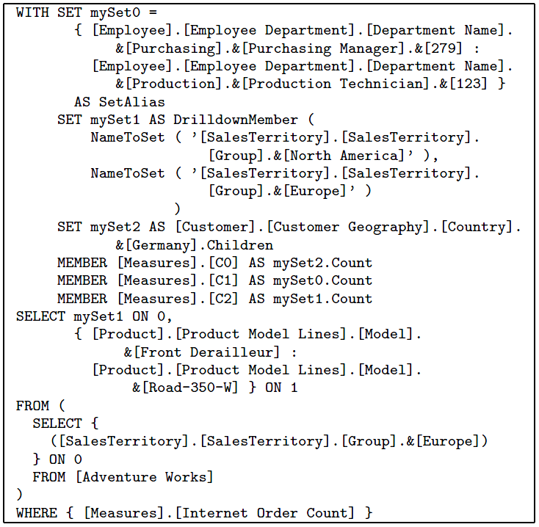
Motivating Example
MDX query causes an exception in SQL Server Analysis Services
Simplified repro:
Requires:
Nested SELECT clause
DrilldownMember function with NameToSet parameter
Specific projection on the 0 axis
Data is key – need to minimize
Data table with
billions of rows
Notes:
MultiDimensional eXpressions
User discovers that the following MDX query causes an exception in SSAS. Wants to submit a bug report to Microsoft, so takes the following repro expression and his dataset.
So the Microsoft developer takes the repro expression and dataset and attempts to minimize it to determine the root cause of the exception.
Often the user submitting the bug report can’t share his dataset either because it’s too large or perhaps contains sensitive information. Hence a tool that can help minimize the data along with the query expression is desirable.

Slide 4
Automatically Isolate DBMS Bugs with FlexMin
First to minimize data & query expression
Novel hinting language helps guide minimization strategy
Applied in context of SQL and MDX
Results show significant improvement over prior work
Minimize SQL (~50 lines) & data (~ millions of rows) in minutes
Other approaches take hours and don’t minimize data
Notes:
FlexMin is a tool that isolates bugs by minimizing the data and query expression.
Since the interplay between data and the expression is complex, we’ve developed a novel hinting language so the user can optionally help guide the minimization strategy.
FlexMin can minimize complex MDX and SQL expressions and input data tables (order of millions of rows) in minutes.

Slide 5
Outline
Problem Statement
Prior work:
Delta debugging (DD)
Hierarchical Delta debugging (HDD)
SIMP
FlexMin Overview
Experimental Results
Conclusions
Software Engineering
Database
Notes:
I’ll first go over the terminology and problem statement for minimizing repros
DD: seminal work from software engineering community,
minimize repros in context of procedural C languages
partitions initial repro into chunks and attempts to reduce by removing each partition
SIMP: Nico’s EDBT 10 work, first attempt to minimize repros in context of query languages

Slide 6
Outline
Problem Statement
Prior work:
HDD,DD, SIMP
FlexMin Overview
Experimental Results
Conclusions
Notes:
I’ll first go over the terminology and problem statement for minimizing repros

Slide 7
Repro Minimization Problem Statement
Apply Simplifications:
S: repro → repro’ where length(repro’) < length(repro)
Test repro’:
Finding global minimum repro is exponential
Assumptions to reduce complexity
Monotonicity:
1-minimality:
repro’
Testing function
DBMS
Exception/error
✗
repro’ exposes bug
✓
repro’ does NOT expose bug
s
repro’ is syntactically correct but fails semantic check
?
any other unexpected condition
Local minimum
guarantee
Notes:
Given a repro expression, we want to simplify it.
Simplification is simply a function that is applied to a string repro expression and returns a repro expression repro’ that is smaller in size
The search problem of finding the minimal repro is exponential in the size of the original repro.
Monotonicity: if a repro r passes, then no simpler version of r would expose the bug
1-minimality corresponds to a local minimum with respect to a family of simplifications

Slide 8
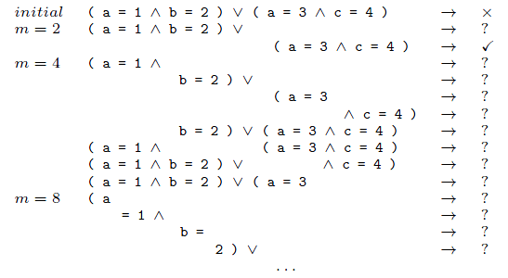
Delta Debugging (DD) for SQL
Reminiscent of binary search:
Partition input repro r into m chunks
Reduce r by removing each of the m partitions of size |r|/m from r
T(r’)
If result is✗then recur on r’
Else, test complements of r’ …
Simple grammar for predicates
Bug: cannot handle repeated variables
Repro:
Goal:
DD trace:
T(r)
Not effective for SQL [Bruno EDBT10]
Best case minimized repro is:
Insight 1: Good for minimizing items with homogeneous, repetitive structure (e.g. lists, string literals, data tables).
Notes:
DD: from software engineering community, partitions initial repro into chunks and attempts to reduce by removing each partition
DD does not take structure into account, and many simplifications result in syntax errors,

Slide 9
Outline
Problem Statement
Prior work:
HDD,DD, SIMP
FlexMin Overview
Experimental Results
Conclusions
Notes:
I’ll first go over the terminology and problem statement for minimizing repros

Slide 10
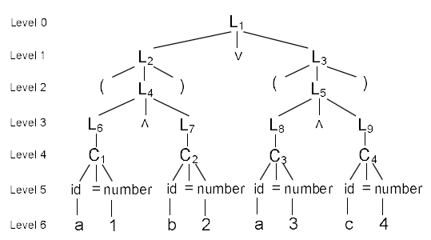
Hierarchical Delta Debugging (HDD)
Input repro is a parse tree
Applies Delta-Debugging (DD) to nodes at same level
DD is simpler, string-based idea like a binary search
Simple grammar for predicates:
Bug: cannot handle repeated variables
Repro:
Goal:
HDD tree:
✔
Simultaneous non-consecutive
removals are required
?
✔
Best case minimized repro is:
Insight 1: Good for minimizing items with homogeneous, repetitive structure (e.g. lists, string literals, data tables).
Notes:
Level 0 returns the root L1 since the empty string does not fail
Level 1 cannot discard any of the three elements.
Level 2 fails to remove any parenthesis since two simultaneous non-consecutive removals are required to eliminate a pair of parens.

Slide 11
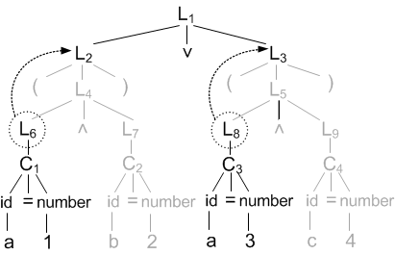
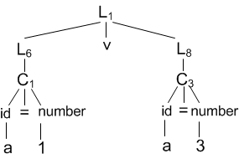
SIMP
Like HDD repro is parse tree, but…
Leverages node-level grammar rules to perform more focused simplifications
Replace internal nodes, get syntactically valid repros

Slide 12
SIMP: Applying Simplifications
1- Consider each internal node n in parse tree
2- Consider each grammar rule g with LHS=n
3- Identify sub-trees that match g’s RHS
4- Transform parse tree → r’ and test T(r’)
5- If T(r’) = ✗ then recur on smallest repro so far, else prune
Insight 2: Good for minimizing clauses with complex, heterogeneous structure (e.g. nested subexpressions).
Notes:
Because it takes the parse tree structure into account through the grammar rules when performing simplifications we get the following insight.

Slide 13
SIMP: Applying Simplifications
1- Consider each internal node n in parse tree
2- Consider each grammar rule g with LHS=n
3- Identify sub-trees that match g’s RHS
4- Transform parse tree → r’ and test T(r’)
5- If T(r’) = ✗ then recur on smallest repro so far, else prune
Insight 2: Good for minimizing clauses with complex, heterogeneous structure (e.g. nested subexpressions).
Notes:
Because it takes the parse tree structure into account through the grammar rules when performing simplifications we get the following insight.

Slide 14
FlexMin Overview
Automatically minimizes repro expressions
Based on SIMP but applies DD to list nodes
Any nodes with homogeneous structure
Improved enumeration strategy
Avoids getting stuck on local minima
Applies DD to minimizing input data tables
Novel hinting language helps guide minimization order
Notes:
We introduce FlexMin, our framework that unifies the two key insights I just presented from prior work.
FlexMin isolates bugs by minimizing the query expression (using a combination of SIMP and DD) and data (using DD).
We improve upon SIMP’s enumeration strategy that avoids dead ends
Since the interplay between data and the expression is complex, we’ve developed a novel hinting language so the user can optionally help guide the minimization strategy.

Slide 15
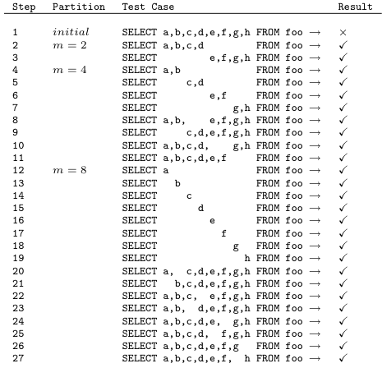
FlexMin: Application of DD to List Nodes
Apply DD to list nodes with grammar rule:
e.g any repetitive sequence of items such as a list of columns
Specialized DD gives significant time savings over SIMP
O(n²) vs. O(n⁴) worst-case, n is # of nodes in sequence
SELECT a,b,c,d,e,f,g FROM foo
Notes:
Alpha, beta, and gamma contain zero or more terminal or non-terminal nodes that do not produce L

Slide 16
FlexMin: Improved Enumeration Strategy
SIMP: Applies all simplifications before moving on to next node
Can get stuck applying changes to irrelevant
nodes
FlexMin: round robin-based approach
SIMP | FlexMin X = 5
C₁…C₁₀ | C₁…C₅
C₁₁,C₁₂ | C₁₁,C₁₂
C₁₃…C₂₀ | C₁₃…C₁₇
C₂₁…C₂₅ | C₂₁…C₂₅
C₂₆…C₃₀ | C₂₆…C₃₀
 | C₆…C₁₀
 | C₁₈…C₃₂
Repro parse tree
Notes:
FlexMin takes a round-robin approach and applies only a few of the simplifications to each of the nodes at a time.
Avoids getting stuck on local minima. For example if we have 2 select statements in our initial repro.
The first SELECT is more complex than the 2nd (which is the one containing bug).
SIMP would try all changes starting from root node of first SELECT before going to the next one.
Hence it may get stuck applying unnecessary transformations from a root node that will lead to a local minimum.

Slide 17
FlexMin: Application of DD to Data
Specialized DD for data minimization
Systematic removal of rows of data from input table
Partition original table into m chunks
Create temp table for each chunk
Insert temp table id into repro expression and apply T(r’)
But, minimizing data affects time and outcome of query minimization
E.g. minimize input tables before performing join
Notes:
User may have information that can guide minimization strategy --

Slide 18
FlexMin-Data & FlexMin-Hints
Novel hinting language to guide minimization strategy of data and query expression
FlexMin-Data:
“Minimize the expression using SIMP or DD before/after minimizing the data.”
SELECT a,b,c,d FROM /#Data,1#/ foo
FlexMin-Hints (interleave data and query):
“Minimize one subexpression using SIMP or DD before/after minimizing this other subexpression or data.”
/@Isolate,1 Isolate 2, SIMP,2@/
SELECT DISTINCT /#DD,1#/ a,b,c,d,e,f,g FROM /#Data,2#/ foo
WHERE a = 1 AND b = c AND . . .
Notes:
The hints are shown in red
With the first expression, it will attempt to minimize the input data table foo before minmizing the query expression
Perhaps the user wants to express a more complex interleaving, that is minimize part of the expression then the data then minimize the rest of the expression

Slide 19
FlexMin-Hints
3
1
2
This interleaving saved 12 minutes
Notes:
Turkish I problem : Turkish language has 4 forms of I: dotted and dotless capital and lower-case I. This has caused trouble with character sets.
Minimizing data tables can affect the time and outcome of query minimization, depending on how they are ordered relative to each other. Data minimization relies on hinting language which allows the user to convey domain specific information through the hinting language.
With the first expression, it will attempt to minimize the input data table foo before minmizing the query expression

Slide 20
Evaluation Overview
Compare DD, HDD, SIMP, and FlexMin
Mix of synthetic and real bugs
Simulate behavior of bug in testing function
SQL Server 2008 and Microsoft Analysis Services (MDX)
7 minimize query, 2 minimize data + query
System config:
2 x 2.4 GHz Quad-Core Intel Xeon
11 GB RAM, 1 TB disk
Metrics:
Size of resulting repro expression (reduction factor, % reduced)
Total time spent reducing (includes technique overhead)
Notes:
All run on a single machine configured with 2 2.4GHz quad-core Intel Xeon processors and 11 GB RAM.
Reduction factor: how much the original input repro was reduced

Slide 21
Repro Minimization Results
3-7 min
2 min
20 min
> 1 hr
25% avg.
improvement
Reduction Factor (%)
Repro Minimization Experiment
Notes:
Reduction factors for these first three experiments (relatively simple repro expressions to begin with, ~10 lines ) are about the same for FlexMin and SIMP (and worse for HDD and DD). FlexMin and SIMP both reduce the repro expression by over 80%.
These four experiments are more complex repro expressions on the order of 40 to 50 lines of SQL (e.g. HpMerge73 contains a SELECT subquery nested 7 levels deep)
SIMP gets stuck minimizing a large expression early on that has nothing to do with the bug and times-out after an hour.
Overall for these experiments FlexMin produces smaller repros in less time compared to the approaches from prior work.

Slide 22
Repro + Data Minimization Results
16 min
4 min
16 min + manual inspection of
6 datasets, containing millions
of rows
Reduction Factor (%)
Repro + Data Minimization Experiment
Notes:
1. In these two experiments we apply FlexMin-Data and FlexMin-Hints to minimize data along with the repro expression.
2. In the experiment on the left, only FlexMin-Data and Hints (shown in light blue and dark blue) and SIMP were able to minimize the expression. The dataset, which contained over a million tuples was minimized down to the failing row in for both FlexMin variants.
In the 2nd experiment, not only were the 2 FlexMin variants able to minimize the repro expression by 97%, but they were able to minimize the offending data table with 1.9 million rows, down to 1 row in a matter of seconds.
- SIMP was able to minimize the expression by 72%, but you are forced to manually inspect the 6 tables to find the offending record

Slide 23
Conclusion
DBMSs and their applications are complex
Debugging is time-consuming
FlexMin is a tool automatically isolates bugs in DBMS
Add data minimization as a key component to bug isolation
Introduce novel hinting language to help guide minimization strategy
Improve upon prior work

Slide 24
MDX Exception
?
(s)
✗
✔
Notes:
Reduction factor: how much the original input repro was reduced
SIMP is shown in two forms with original enum strategy and with round robin enumeration strategy

Slide 25
MDX Exception
?
(s)
✗
✔
Reduction factor: # tokens input - # tokens output
# tokens input
Notes:
Reduction factor: how much the original input repro was reduced
SIMP is shown in two forms with original enum strategy and with round robin enumeration strategy

Slide 26
Turkish ‘I’ Collation Problem
‘I’ represented as: {İ,I,i,ı}
Causes problems with case folding, string comparison, sorting, etc.
Microsoft .NET workaround
Notes:
Example computes the Kevin Bacon number for actors in the Borat movie. User has intuition that failure may originate with the international cast of characters from the Borat movie.

Slide 27
Turkish ‘I’ Collation Problem
19 mins
3.5 mins
Data table has 1.9 million rows
FlexMin-Data and FlexMin-Hints minimized to 1 row
Better time-wise to remove unnecessary projections, minimize data table, then apply SIMP to rest (FlexMin-Hints)

Slide 28
Evaluation: Scalability
SIMP vs. FlexMin
Real world query optimizer test:
Check to see if two different settings produce same query plan
Setting (a): uses traditional query optimizer
Setting (b): uses query optimizer with plan hints
SQL Server 2008
Complex initial repros: 43-50 lines of SQL

Slide 29
Evaluation: Scalability
SplitMerge75
Legend
HpMerge64
Notes:
SplitMerge75: SIMP made 5 X as many test calls as FlexMin + RR

Slide 30
Evaluation: Scalability
> 1 hour!
HpMerge73
~ 3 mins
Legend
RiMerge26
~ 11 mins
~ 6 mins

Slide 31
To change/modify:
1. give an example of a testing function
Example maybe in context of real-world scenario (e.g. exception, would capture exception message)
Change definition of repro to Magda’s
Typo possibly in MDX server exception (final repro expression)

Slide 32
Query Minimization Results
Notes:
Reduction ratios for these first three experiments (relatively simple repro expressions to begin with, < 12 lines ) are about the same for FlexMin and SIMP (and worse for HDD and DD)
These four experiments are more complex repro expressions on the order of 43 to 50 lines of SQL (e.g. HpMerge73 contains a SELECT subquery nested 7 levels deep)
Overall for these experiments FlexMin produces smaller repros in less time compared to the approaches from prior work.

Slide 33
Data and Query Minimization Results
Notes:
Turkish ‘I’:
Data table has 1.9 million rows, FlexMin-Data and FlexMin-Hints minimized to 1 row in a matter of seconds. With SIMP have to manually inspect the table to find the offending record

Slide 34
Outline
Problem Statement
FlexMin Overview
Builds on prior work
Experimental Results
Conclusions
Notes:
DD: seminal work from software engineering community,
minimize repros in context of procedural C languages
partitions initial repro into chunks and attempts to reduce by removing each partition
SIMP: Nico’s EDBT 10 work, first attempt to minimize repros in context of query languages

Slide 35
SIMP Algorithm: Simplifications Considered
Each node in tree has set of grammar rules
Simplifications based on grammar rules
Applied to all non-terminal nodes in tree
Input repro:
1,2,3
Grammar rule:
List → Num | List , Num
Repro parse tree
1
2
3
TODO: CHANGE THIS TO A QUERY
Notes:
DD: from software engineering community, partitions initial repro into chunks and attempts to reduce by removing each partition
Need an SQL example for this…. Dan S was confused by the 1,2,3… are we minimizing data or a query?

Slide 36
SIMP Algorithm: Simplifications Considered
Each node in tree has set of grammar rules
Simplifications based on grammar rules
Applied to all non-terminal nodes in tree
Input repro:
1,2,3
Grammar rule:
List → List , Num
Repro parse tree
Generates all combinations of simplifications from:
{List₁,List₄} and
{Num₃,Num₆,Num₇}
Notes:
Starting with the root node List0, and one of it’s grammar rules, SIMP identifies all the root nodes of candidate subtrees that will participate in the simplification of List0.
Then SIMP generates all possible combinations of these candidate sets {List1, List4} and {Num3, Num6, Num7} based on the grammar rule in red, discarding any invalid combinations (e.g those that do not respect the hierarchy order – swapping List4 and List1).
Finally List0’s children are replaced by each of these valid subtrees and tested.

Slide 37
FlexMin Overview
Automatically minimizes repro expressions
Unifies ideas from DD and SIMP
DD: Apply to nodes with homogeneous structure
Lists, string literals, data tables, sequence of statements, etc.
SIMP: Apply to nodes with heterogeneous structure
Complex expressions, clauses, nested subexpressions, etc.
Based on language grammars
Improved enumeration strategy
Avoids getting stuck on local minima
First technique to minimize data and query repro
Novel hinting language to optionally guide minimization strategy
Notes:
We introduce FlexMin, our framework that unifies the two key insights I just presented from prior work. How can we more intelligently leverage these key insights into a unified framework?
Like SIMP, input repro is converted into a parse tree representation with grammar rules at each node. Simplifications applied to each node in breadth-first order

Slide 38
FlexMin
Shares with SIMP:
Generate exhaustive set of simplifications for all nodes in parse tree
Apply to parse tree and test T(r’):
If T(r’) =✗then recur on smallest repro so far
Prune search for T(r’) = {✔,(s),?}
Greedy, 1-minimal guarantee
But improves upon SIMP’s enumeration strategy
Avoids wasting resources on dead ends

Slide 39
FlexMin Contributions
A tool that automatically minimizes repro expressions and data
Unifies ideas from prior work in an improved framework
First to minimize data with query expression
Novel hinting language
Helps guide minimization strategy
Experimental results show improvement over prior work
As small or smaller repros found in all cases
More quickly minimize repro & data

Slide 40
Scope of Bugs
Deterministic runtime bugs:
DBMS crashes, exceptions
Wrong or unexpected results
Optimizer changes
Test two releases of query engine to see if yield different execution plans for same query
Notes:
We mean bug to be any unexpected or undesirable system behavior and we assume the query repro is valid (syntactically correct)
Basically any error whose result can be tested for success or failure

Slide 41
Repro Minimization Problem Statement
Testing function
Simplifications
Problem statement
Assumptions to reduce complexity
Monotonicity:
1-minimality:
‘
s.t.
(
‘
<
)
(
)
Worst-case exponential
Local minimum
guarantee
Notes:
Simplification is simply a function that is applied to a repro expression and returns a repro expression repro’ that is smaller in size
For some function C that measures the complexity of a repro (e.g. C can be the length of the repro)
The search problem of finding the minimal repro is exponential in the size of the original repro.
Monotonicity: if a repro r passes, then no simpler version of r would expose the bug
In other words, 1-minimality corresponds to a local minimum with respect to a family of simplifications

