Slide 1
Testing spatial methods in SQL Server 11.0
Branislav Uzelac
Nemanja Matkovic
Microsoft Development Center Serbia
Danica Porobic
EPFL Lausanne, Switzerland

Slide 2
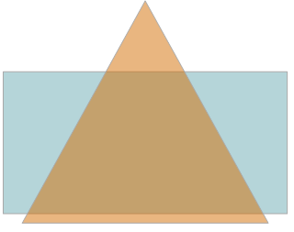
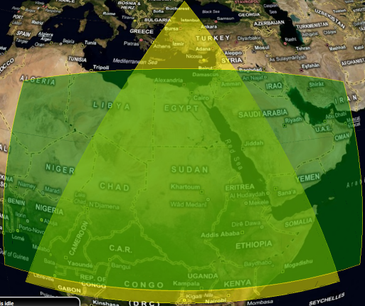
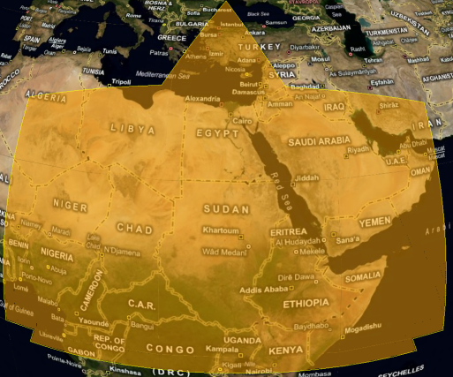
Introduction to Spatial
Geometry
Geography

Slide 3
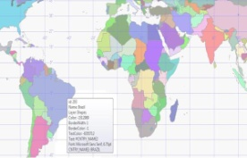
Testing strategy at a glance
Input Data
Verification
methods
World data
Testing methods
Reference library
“Exact equal”
Transformed World data
Static cases
“Approximate equal”
Identity cases
Repro minimization
Generated Data
Minimize
File a bug!

Slide 4
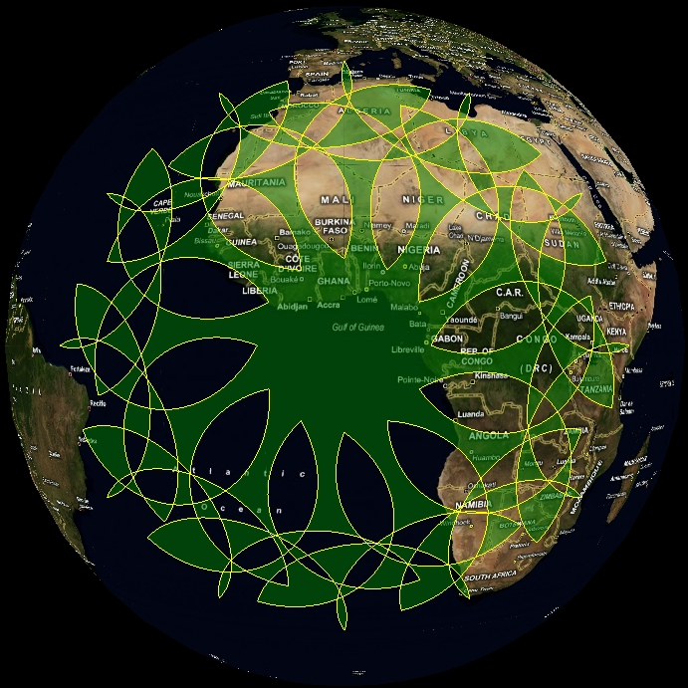
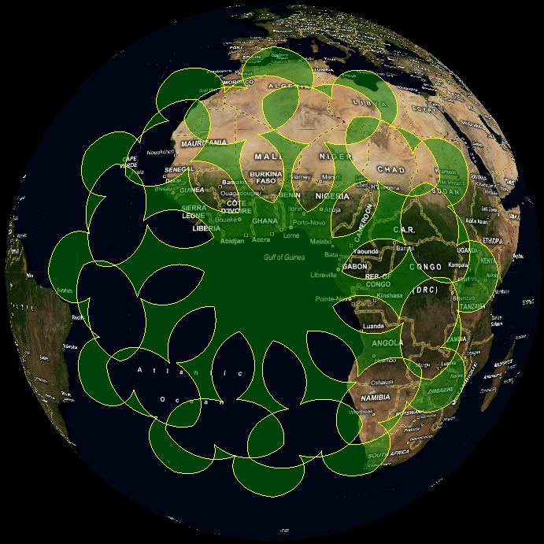
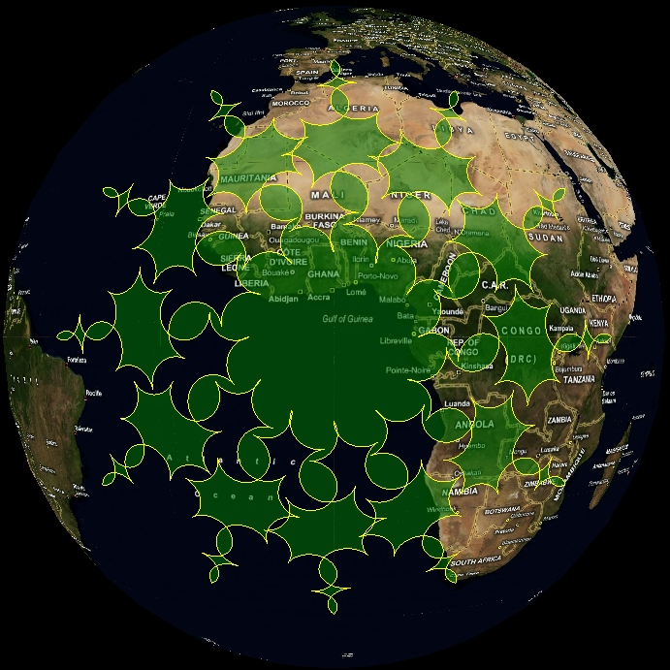
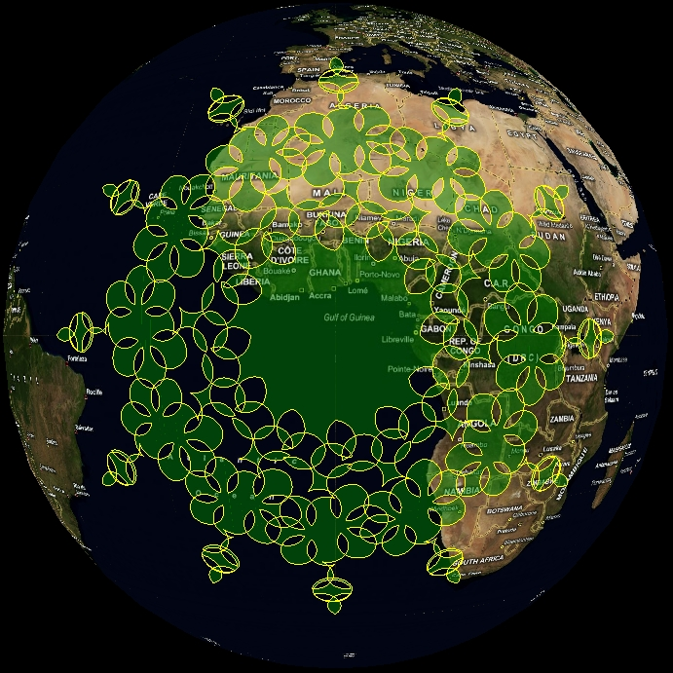
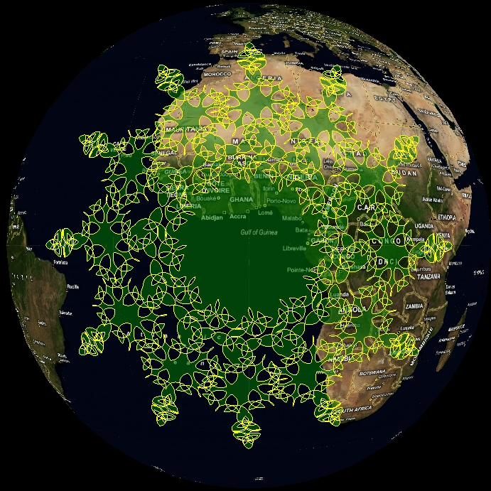
Data generators
Objects tailored for specific aspects of testing

Slide 5
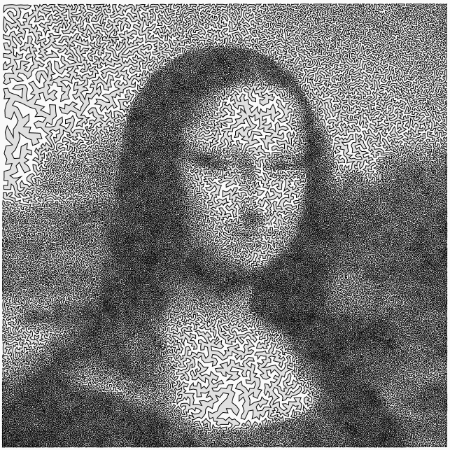
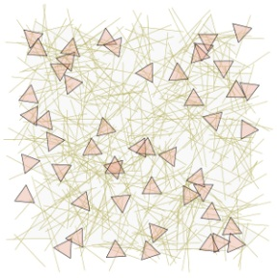
Data generators

Slide 6
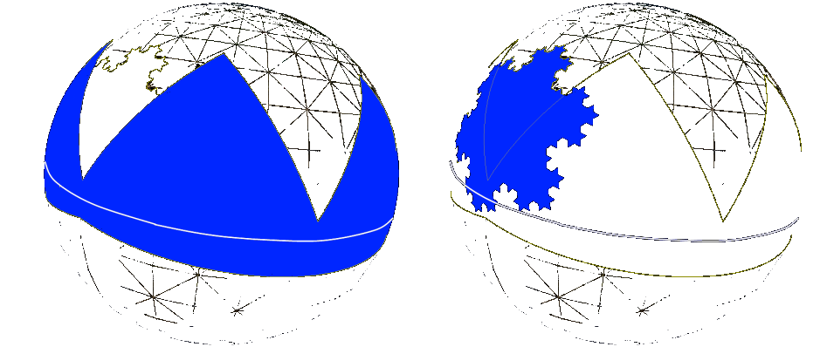
Testing strategy
Mathematical identities
A
B
Identity formula
= $A ∪B$
= $A ∩B$
= A / B
= B / A
= u $∪$
$$∪$$

Slide 7
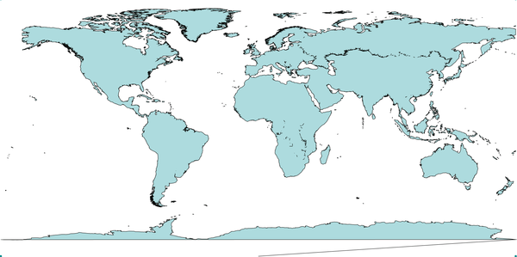
Minimization of bug repro steps
Large objects may have thousands of points
Hard to analyze and pinpoint the problem
Solution: minimize!

Slide 8
Minimization of bug repro steps
Success rate

Slide 9
Questions?
More on spatial: http://www.microsoft.com/sqlserver/2008/en/us/spatial-data.aspx
Contact authors
Branislav Uzelac, bruzel@microsoft.com
Nemanja Matkovic, nemanjam@microsoft.com
Danica Porobic, danica.porobic@epfl.ch

